Slide 1
https://youtu.be/ZU4Xxihi7wI
Notes:
https://youtu.be/ZU4Xxihi7wI

Slide 2
Pepe
Guitarra
By: Yu Yiling, Goh Jia En, Lim Zhan Rong, Lim Jia Yi
One Stop Platform
Curated Resources
For All Ages
Notes:
Hello everyone, we are Pepe Guitarra, and we are proud to present to you our web application, PepeGuitar. Pepe Guitarra, a one stop classical guitar resources platform for all music-learners, providing them with reliable classical guitar resources - ranging from Scores to Useful Youtube Playlist.

Slide 3

The Problem
Overwhelming number of resources and costly fees for learning music in schools.
Unintuitive or clunky user interfaces of existing websites.
Covid-19 has lead to many people being stuck at home and looking for new activities they can do at home.
Notes:
The internet is a excellent place to find resources and information about anything you desire, however it comes with a catch: often, users are inundated by a large number of online resources that are often subpar or stuck behind a paywall.
Learning music in music schools is extremely costly and not for everyone, thus people often turn to the internet to find free resources to use, however when users do find a resource that offers them good quality free content, it is often hidden behind a unintuitive and clunky user interface that makes it painful to navigate and utilize, as can be seen from Chitarrate, our main source of inspiration for our project.
Furthermore, everyone is now stuck at home due to Covid-19, leading to a natural build up of stress and other negative emotions.
With the introduction of affordable or free music learning via online resources, people interested in music but lack money to opt for often expensive music tutors, are now able to effectively learn music through utilizing the many free but valuable resources available online.
We understand that learning music can be expensive and with the internet in our hands, it can be difficult to find good and reliable music resources specifically Classical Guitar.
Moreover, during this Covid-19 pandemic, with everyone facing increasing amounts of stress and anxiety while being coop up at home, many of us turn to new hobbies to relieve emotional stress.

Slide 4

Solution
A website is perfect for everyone to use to learn the classical guitar for free during this pandemic.
Create a website that is able to offer users a selection of scores, categorised by difficulty, and include helpful external resources.
Prioritise user experience and offer users a sleek and beautiful user interface.
Notes:
In order to address the problems mentioned previously, we realised that a website was a great online solution that was free and accessible for everyone, especially during this pandemic whereby people are trying to find new activities to do at home.
Firstly, by creating Pepe Guitar, we are able to compile a range of valuable resources for classical guitar learners, namely a selection of scores that they can easily view in pdf format and also listen to and download via the embedded mp3 player.
Furthermore, we can offer external resources such as spotify and youtube playlists that can not only inspire them but help them gain more knowledge about the classical guitar.
Additionally, by keeping user experience in mind, we came up with an dynamic and interactive user interface that the users can enjoy while browsing and utilizing our website.

Slide 5
Technology Used
HTML
CSS
VUEJS
Well organized and easy to understand Web building
Allow us to link to multiple CSS / JS files
Transition Screen
Styling and Animations
Enhance User Interface
Used for YouTube API
Manage and display data efficiently
BOOTSTRAP
JAVASCRIPT
Python
Responsive layout of content
Styling and format of content displayed
Dynamic Animations and updating of pages
DOM manipulation
Used for dynamically retrieving file names and updating html files
Notes:
Right now, we’ll be moving on to the technology used for developing our web application. We’ve used HTML to structure our web application. For styling, we’ve used CSS, bootstrap and Javascript for features such as the transition screens and animations, and populating of content in our pages, as well as to ensure that our application remains responsive on both desktop and mobile.
VueJS was used together with our YouTube API in managing and displaying our data.
Python was used to dynamically retrieve file names and update the HTML files to display the relevant data.

Slide 6
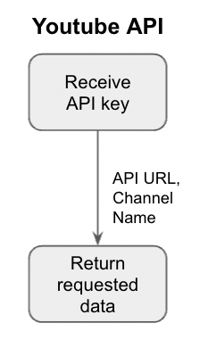
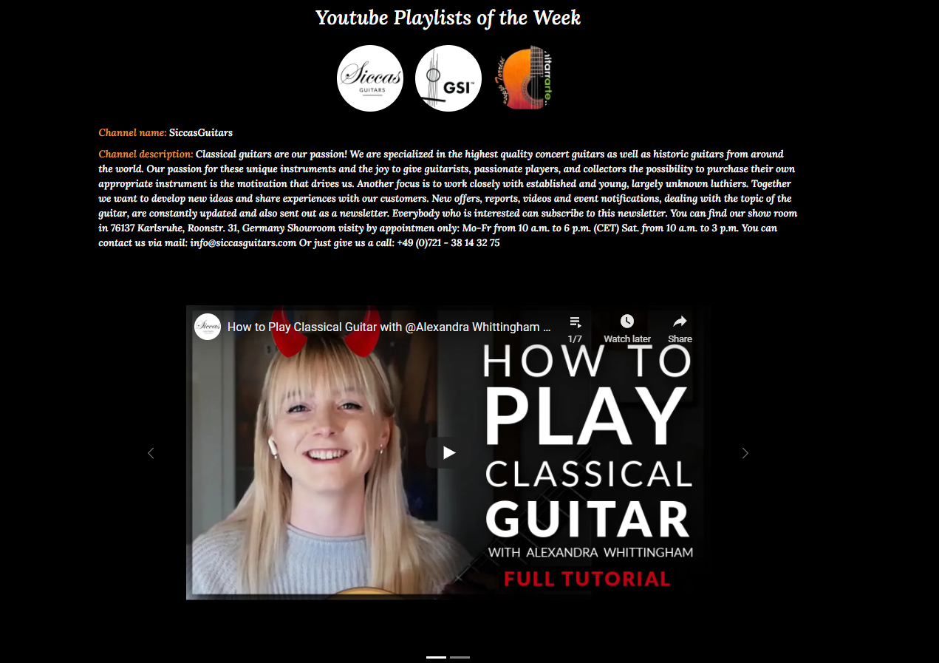

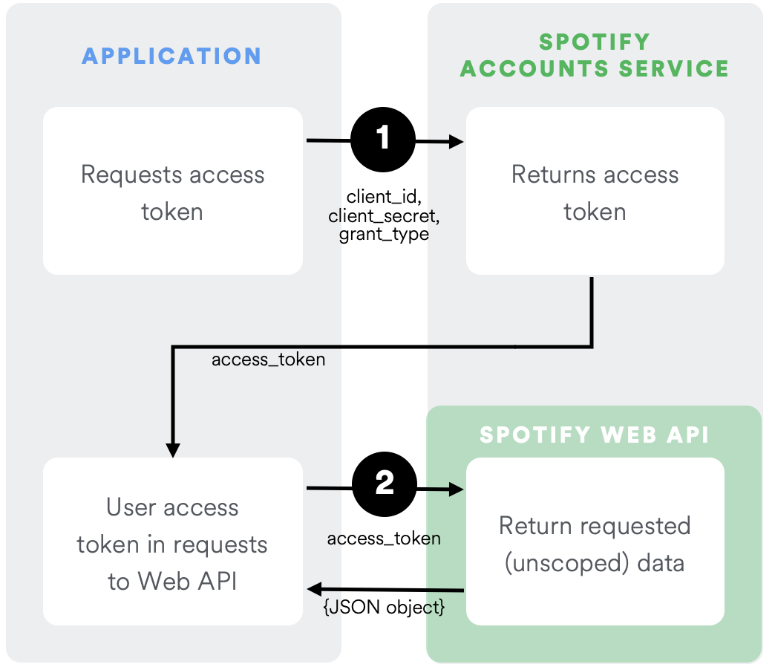
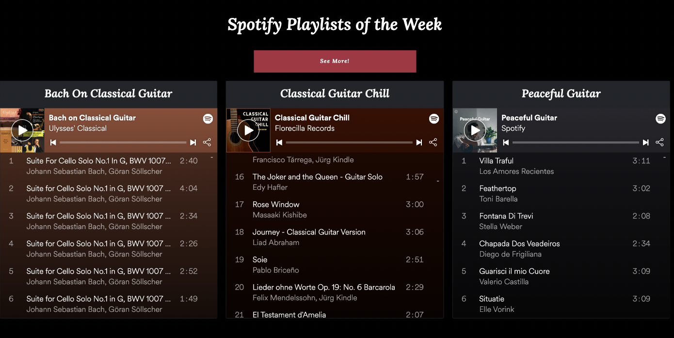

APIs Implementation
Youtube
Spotify
Notes:
Moving on to our API implementation, we’ve implemented two different APIs, namely YouTube and Spotify. For both of these APIs, we have used Axios to retrieve the API data.
In order to integrate the APIs into PepeGuitar, for Youtube API, we retrieve the API key from YouTube Developers Console and using the API URL and specific classical guitar channel names, we manage to retrieve the thumbnail picture, Channel name, Channel description and the playlists. We then implemented the data onto our website using Vue and Bootstrap.
Next, for the Spotify API, we used functions to request the access token directly used the client details taken from Spotify Developers. Once the one-time token is retrieved, we used the access token and API URL to return the requested data - the playlist names, playlists link codes. We then implemented the data onto our website using HTML DOM elements and Bootstrap.

Slide 7

Demo
Notes:
Now Jiaen will begin with the demonstration of our web application, please enjoy.

